Slide 1

Statistical Analysis of Campus Recruitments

Slide 2
Under the guidance of :
Project Team:
Shraddha Bhagwat
Roopa M.S.
Krutika Gawale
Krishna Agarwal
Oshin Bhatt
Gayatri Shinde
Mr. Rahul Kulkarni

Slide 3

Project Objectives
Statistical Analysis of Campus Recruitment
Analysis of students selected from different colleges by different companies.
Statistical Analysis Of Companies Visited On yearly basis

Slide 4
Project Flow
UNIVERSE
EXTRACT
Heterogeneous Sources i.e. operational data (Flat files)
TRANSFORM
Reports Based On Universe
Data warehouse (Sql)
LOAD
(BO XI Rich WebI/WebI)
(BO IDT)
(SSIS)

Slide 5
Source Data
Company source data :
Date
College Name
Company Name
Head office location
Country
Package
Students Selected
Students Participated
Criteria
College source data:
Date
College Name
Location
Survey Name
Number of Indian Students
Number of Foreign Students
Fees
Rank

Slide 6
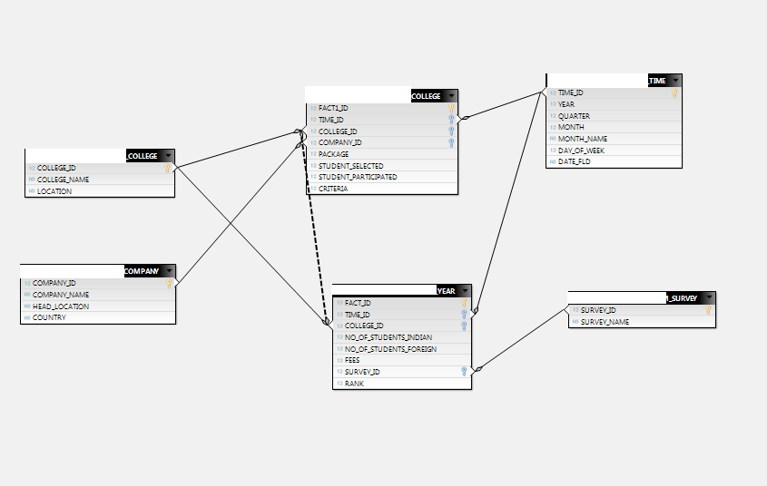
Data Warehouse Star Schema

Slide 7
Staging Tables
Data conversion
(Source)
Sort
Data cleansing
(Ltrim,Rtrim)
Conditional split
(Data validation)
Source
(Company)
Staging Area 1
Sort
Data cleansing
(Ltrim,Rtrim)
Source
(College)
Data conversion
(Source)
Conditional split
(Data validation)
Staging Area 2

Slide 8
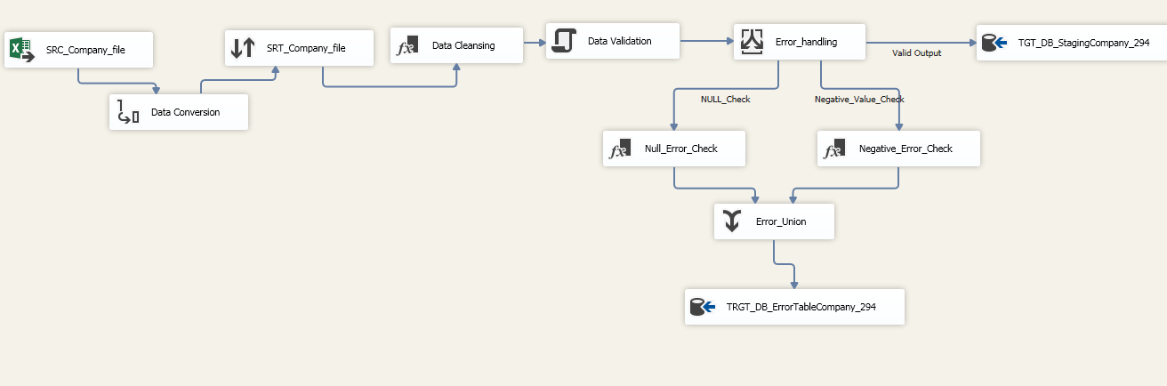
Company Staging Table

Slide 9
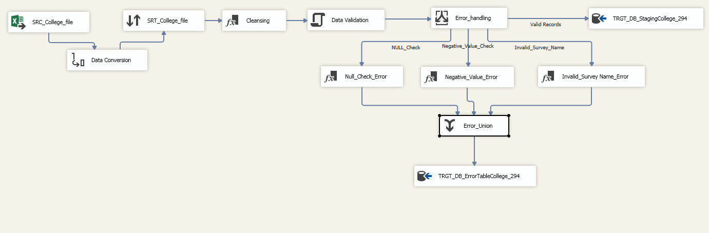
College Staging Table

Slide 10
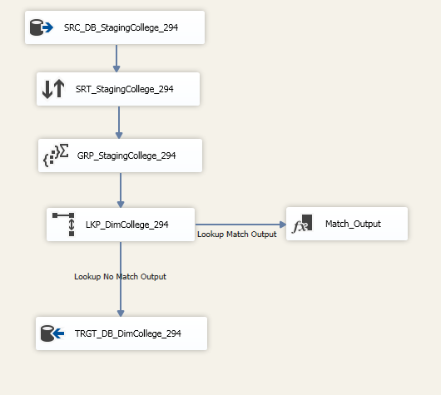
College Dimension Table

Slide 11
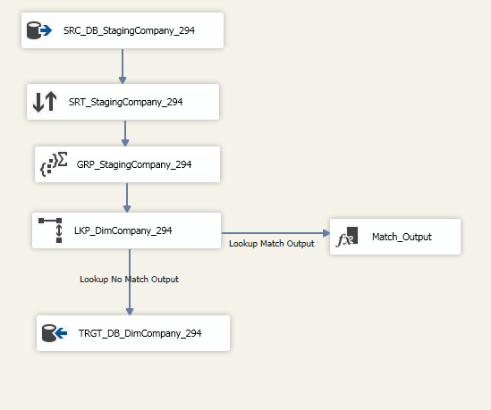
Company Dimension Table

Slide 12
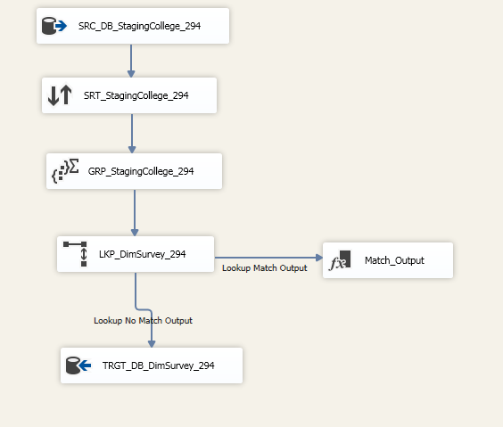
Survey Dimension Table

Slide 13
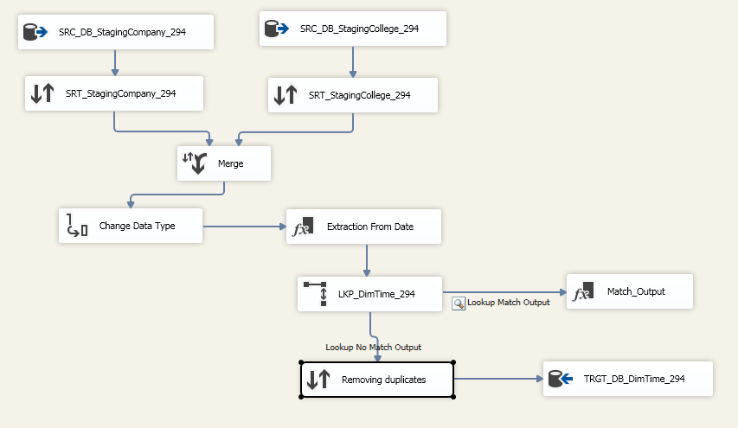
Time Dimension Table

Slide 14
Creation of Player Dimension Table
OLEDB Cleaned Data Tables
(Source)
Player Dimension
T20 Merged Table
Test Merged Table
ODI Merged Table

Slide 15
Populating Fact Tables
College Dimension
(Lookup)
Source
(Staging Area)
College Fact
Survey Fact
Company Dimension (Lookup)
Company Dimension (Lookup)
Company Dimension (Lookup)

Slide 16
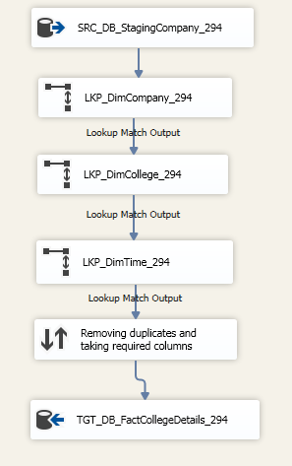
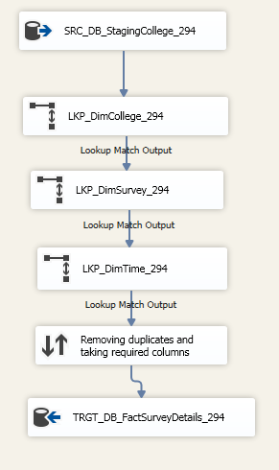
Fact Tables

Slide 17
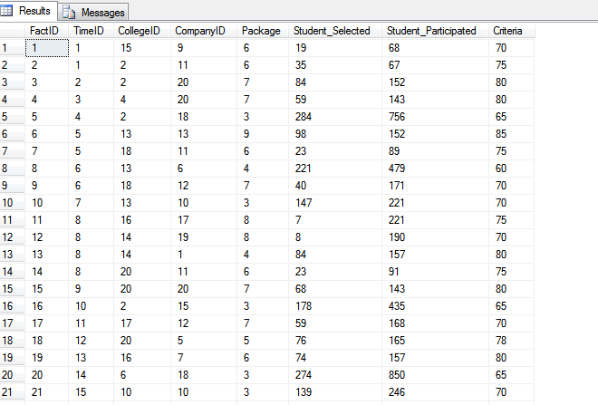
College Fact Table Data

Slide 18
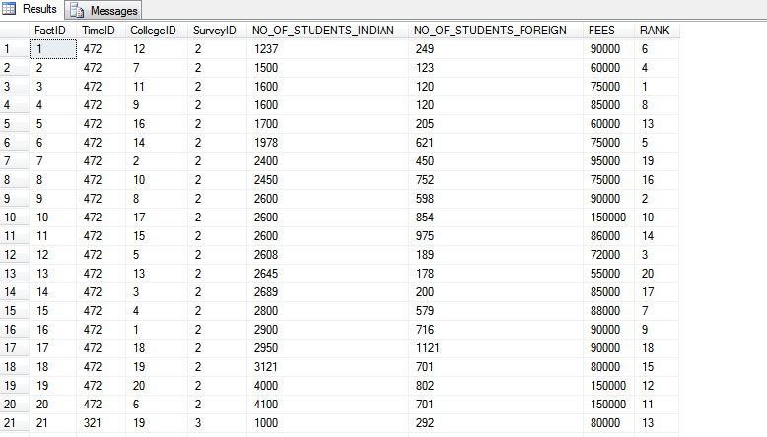
Survey Fact Table Data

Slide 19
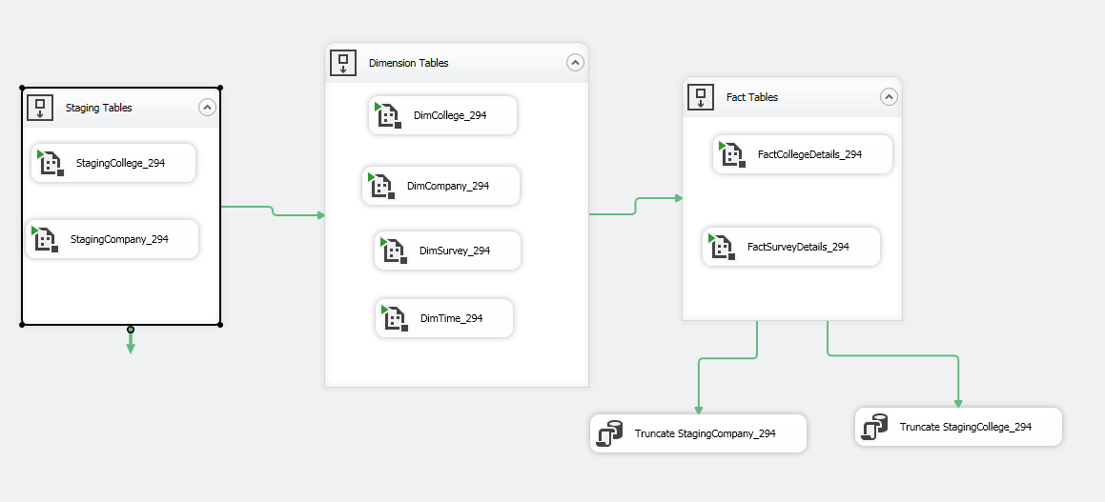
Automation

Slide 20
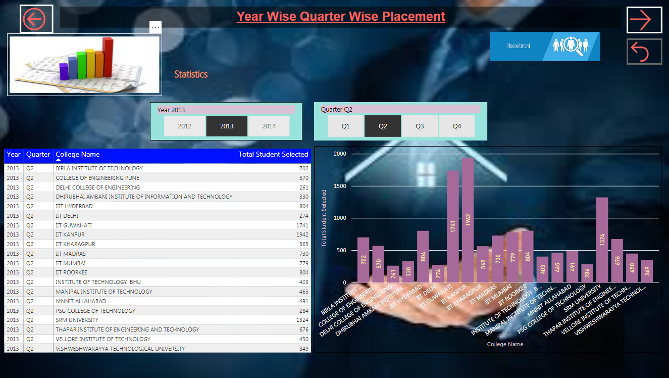
Year Wise Quarter Wise Placement

Slide 21
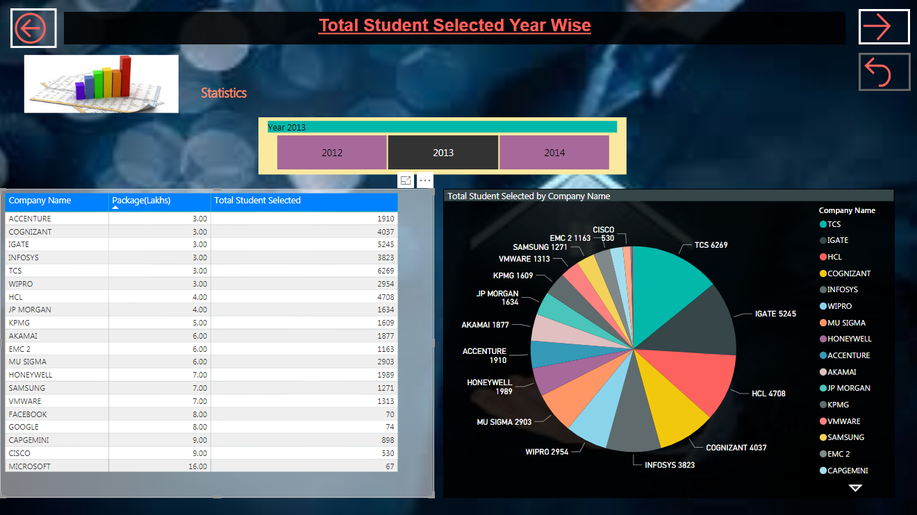
Total Student Selected Year Wise

Slide 22
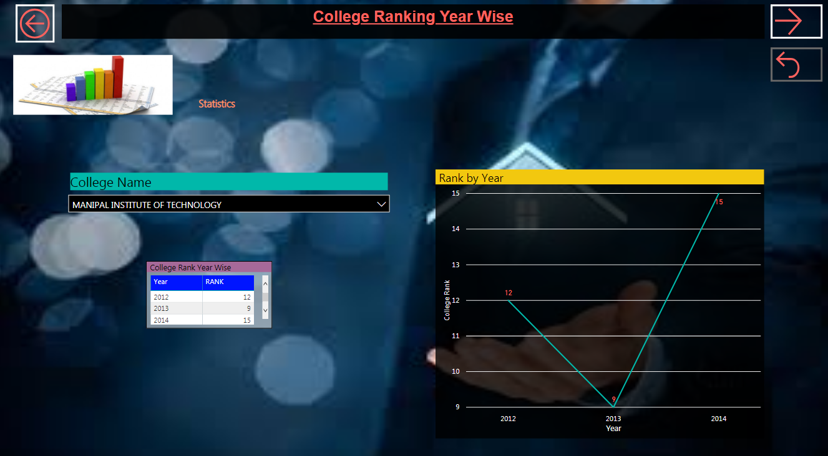
College Ranking Year Wise

Slide 23
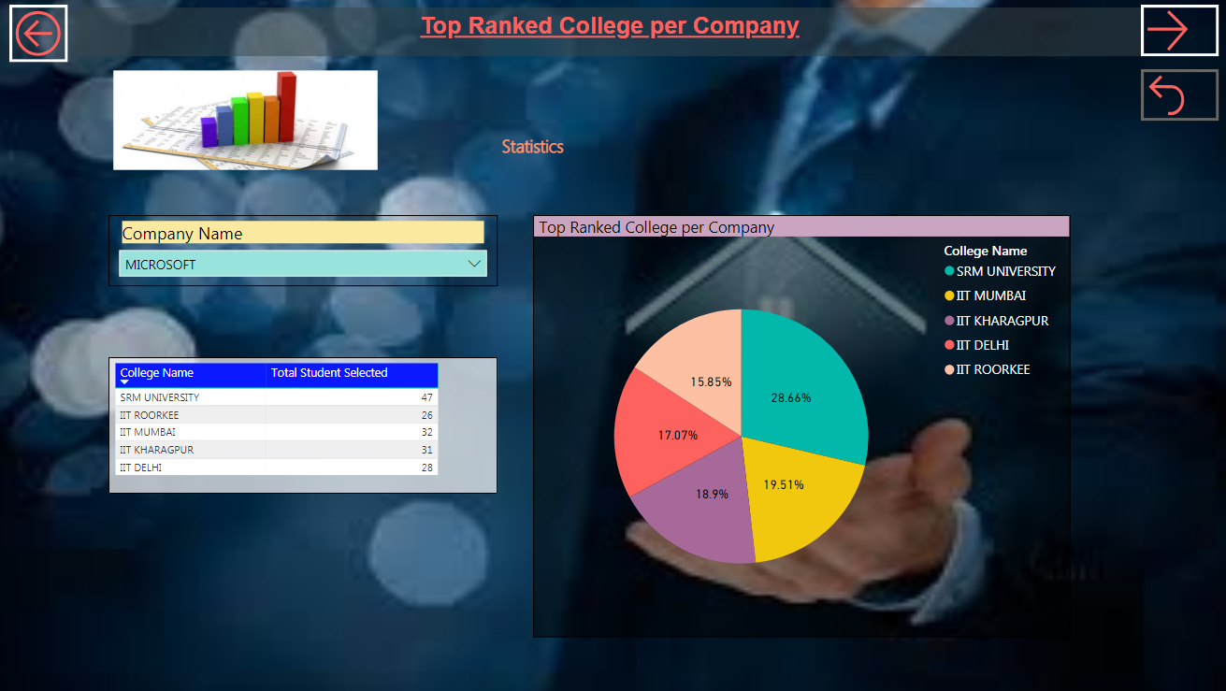
Top Ranked College per Company

Slide 24
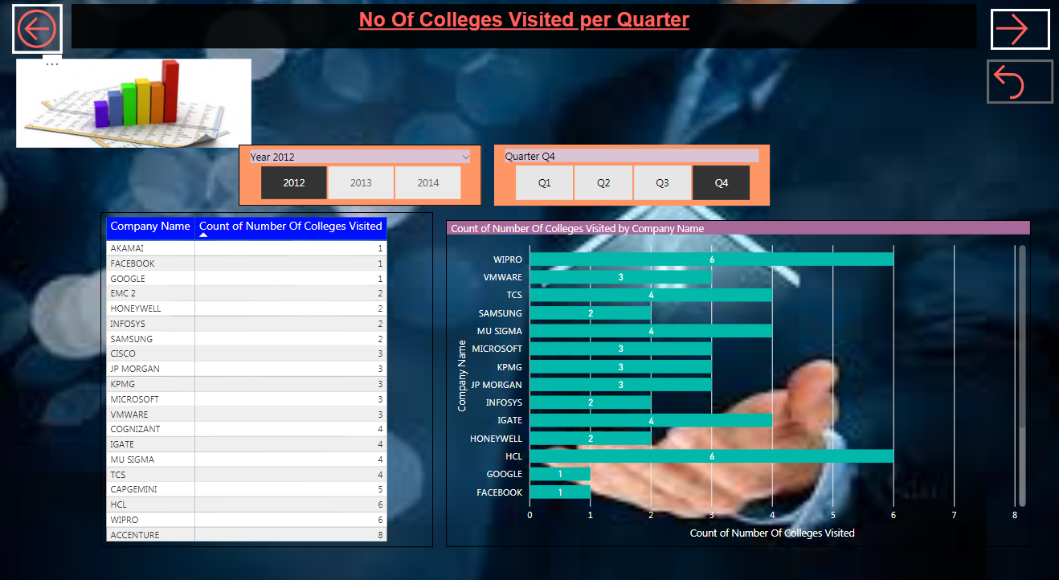
No Of Colleges Visited per Quarter

Slide 25
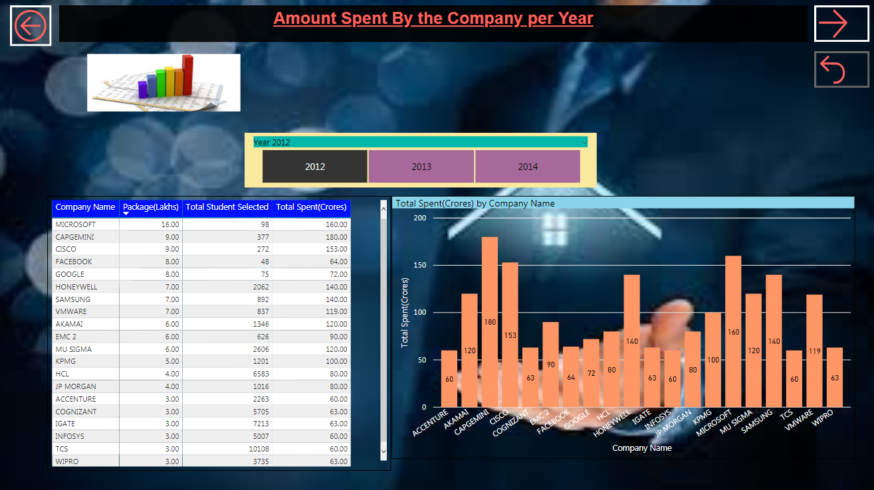
Amount Spent By the Company Per Year

Slide 26

Any Queries?

Slide 27
Thank You

